Slide 1

MI({x, v}, $γ$) > MI(x, $γ$) + MI(v, $γ$)

Slide 2
Previous Slides
That I’ve reported at 2020/03/04

Slide 3
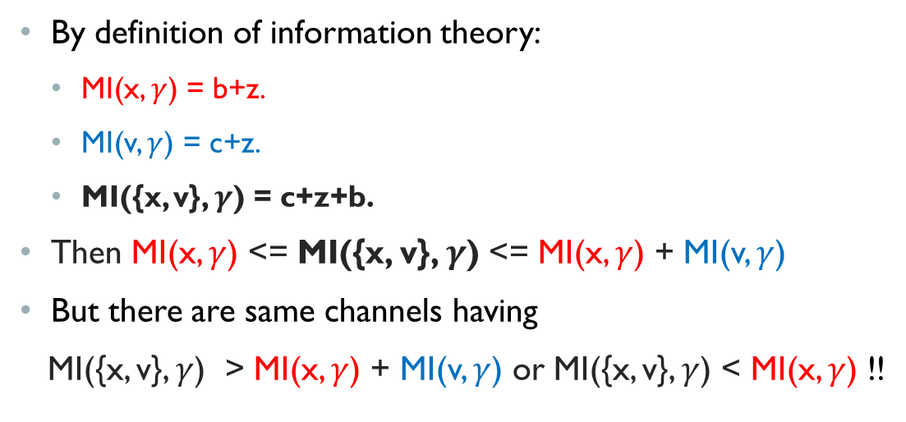

MI({x, v}, $γ$)
x
$$γ$$
𝛾
v
By definition of information theory:
MI(x, $γ$) = b+z.
MI(v, $γ$) = c+z.
MI({x, v}, $γ$) = c+z+b.
Then MI(x, $γ$) <= MI({x, v}, $γ$) <= MI(x, $γ$) + MI(v, $γ$)
But there are same channels having
MI({x, v}, $γ$) > MI(x, $γ$) + MI(v, $γ$) or MI({x, v}, $γ$) < MI(x, $γ$) !!
a
b
z
c

Slide 4
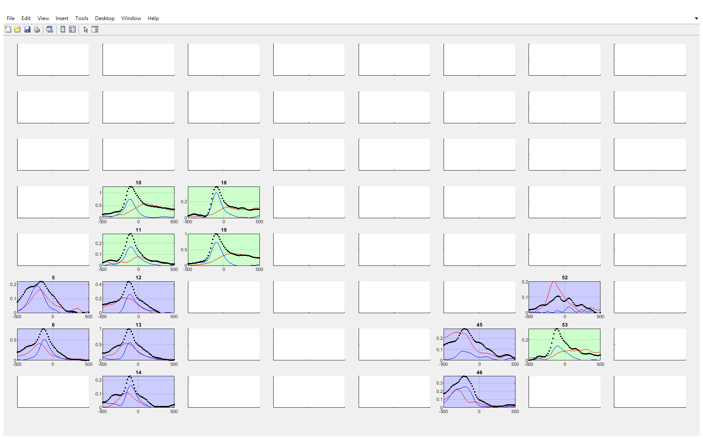
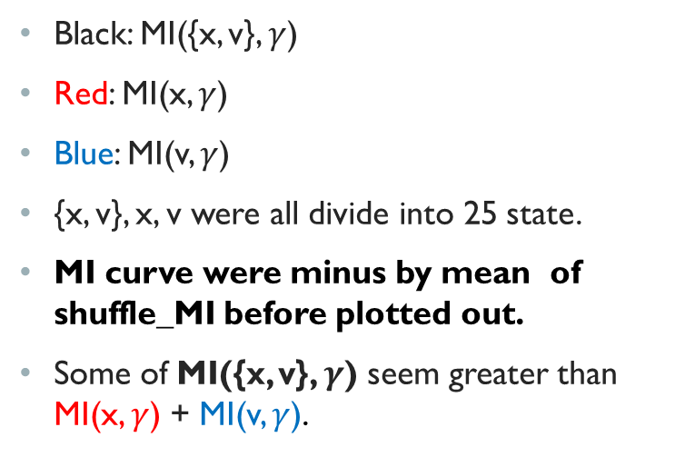
Previous results
Black: MI({x, v}, $γ$)
Red: MI(x, $γ$)
Blue: MI(v, $γ$)
{x, v}, x, v were all divide into 25 state.
MI curve were minus by mean of shuffle_MI before plotted out.
Some of MI({x, v}, $γ$) seem greater than MI(x, $γ$) + MI(v, $γ$).
190823exp ‘MB’

Slide 5
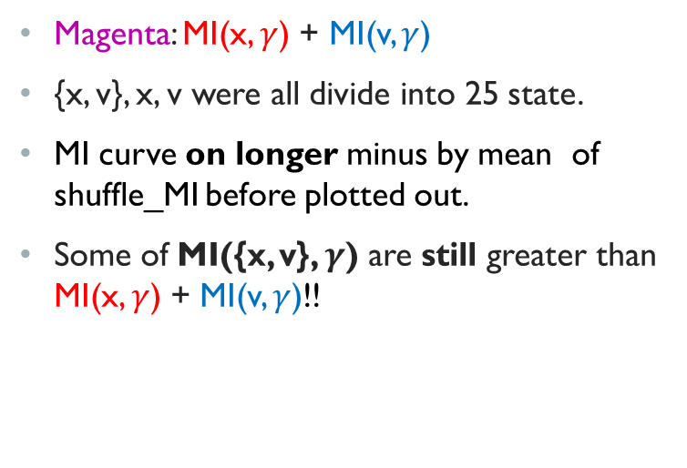
Previous results
Magenta: MI(x, $γ$) + MI(v, $γ$)
{x, v}, x, v were all divide into 25 state.
MI curve on longer minus by mean of shuffle_MI before plotted out.
Some of MI({x, v}, $γ$) are still greater than MI(x, $γ$) + MI(v, $γ$)!!
190823exp ‘MB’

Slide 6
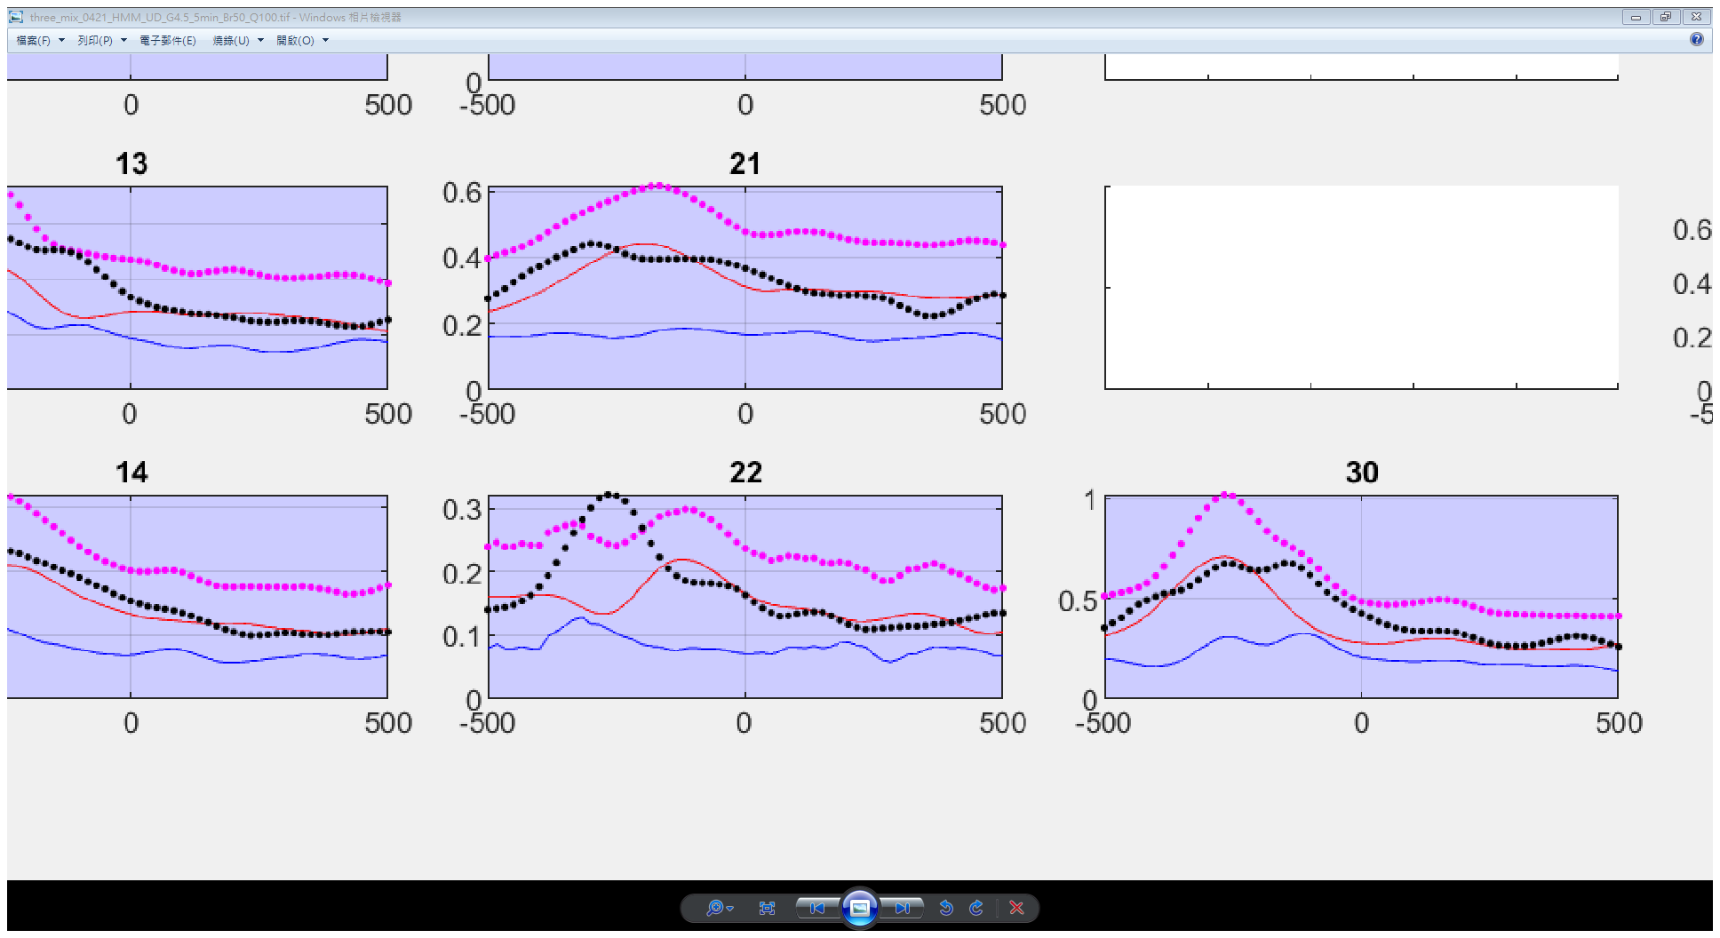
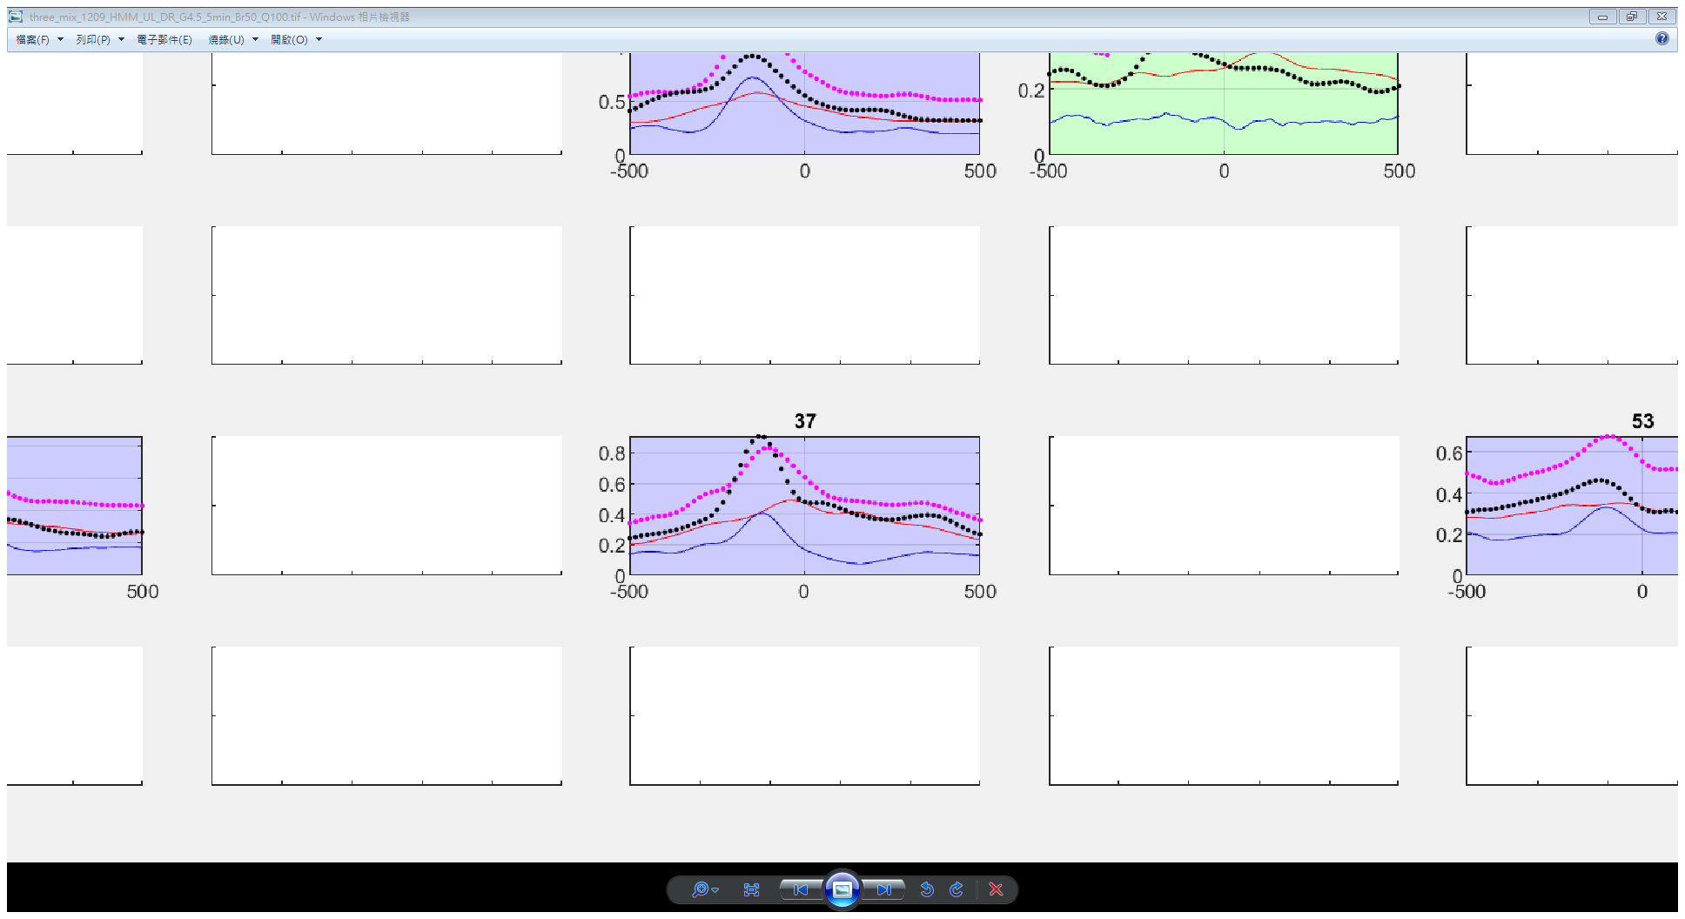
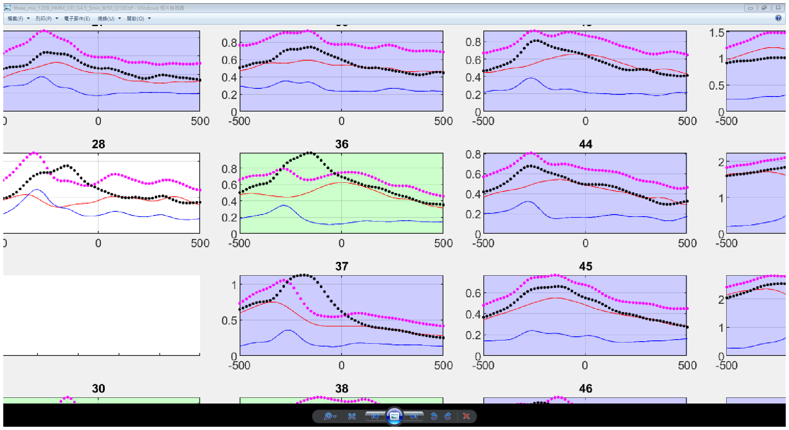
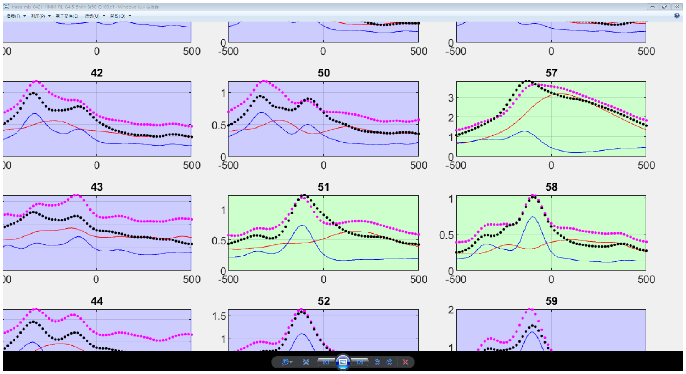
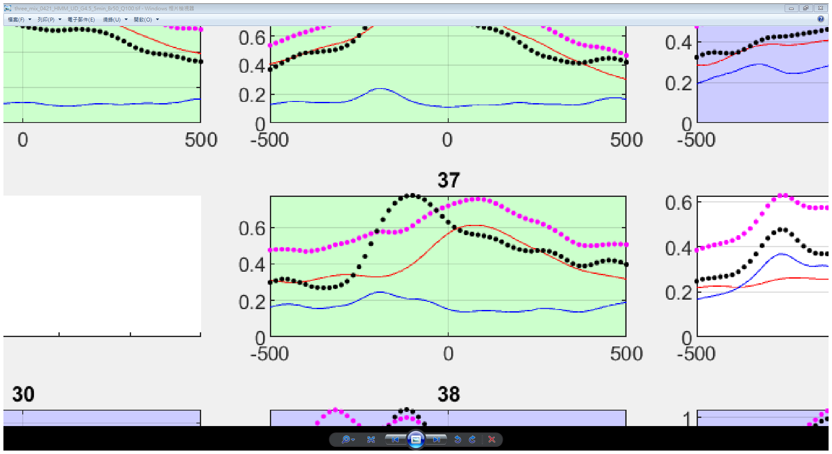
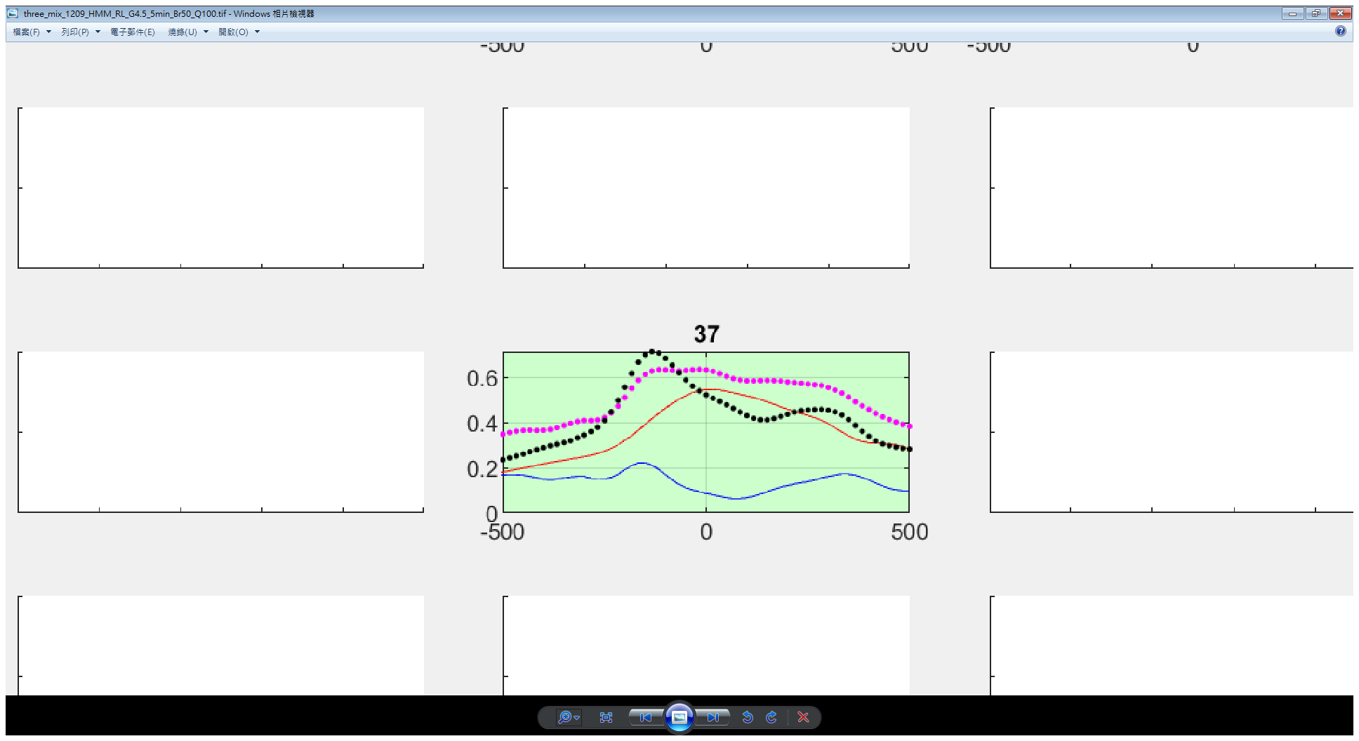
Other similar results
191208exp
191219exp
200119exp

Slide 7
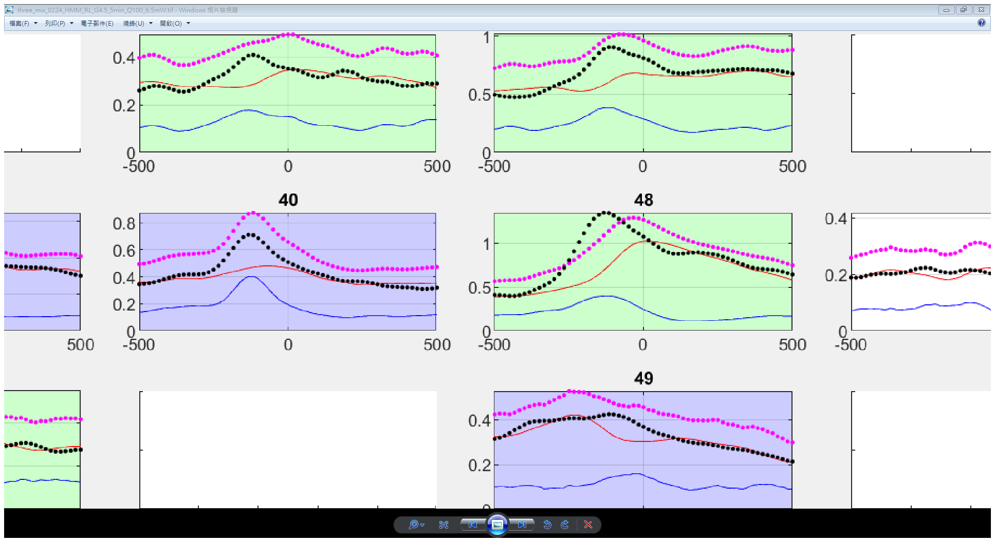
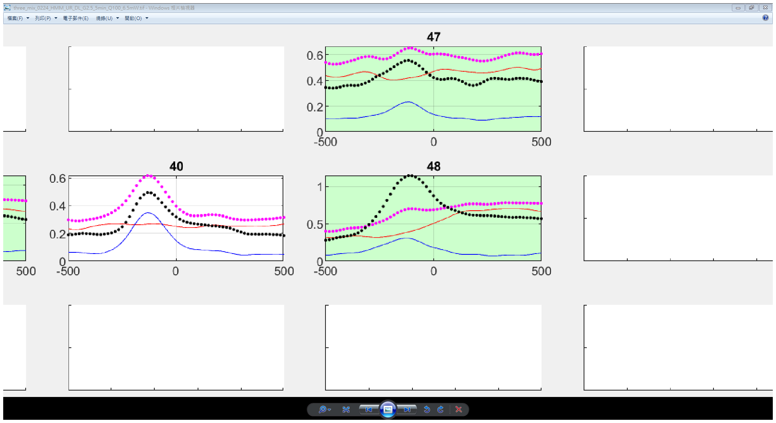
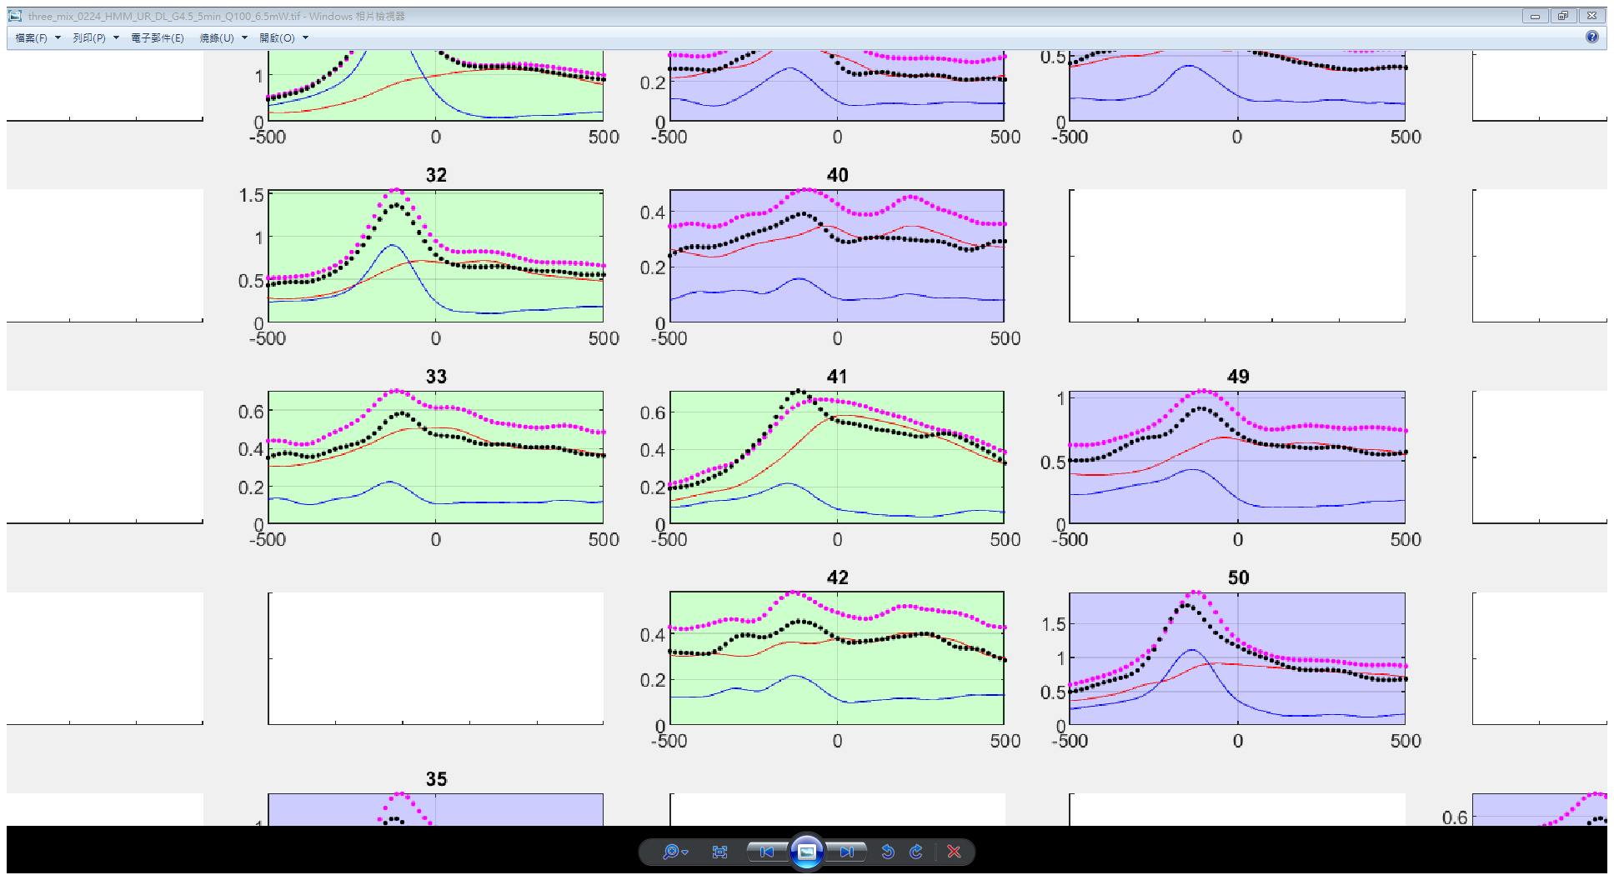
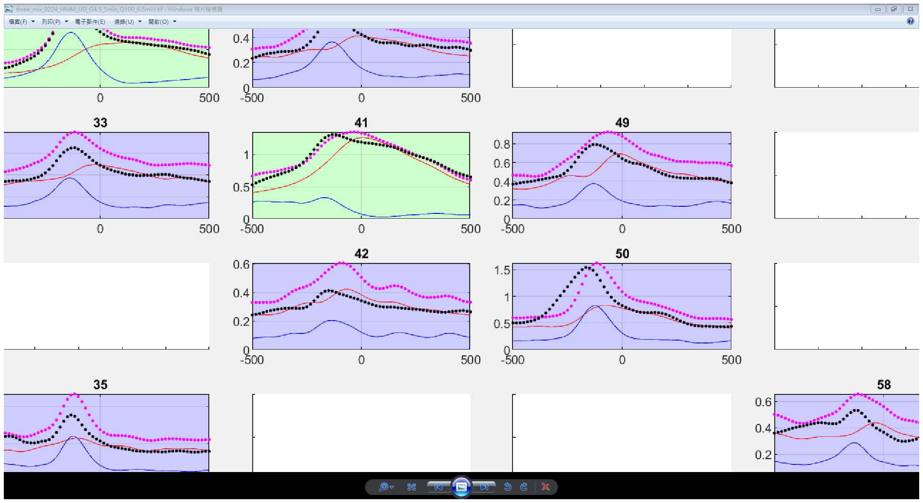
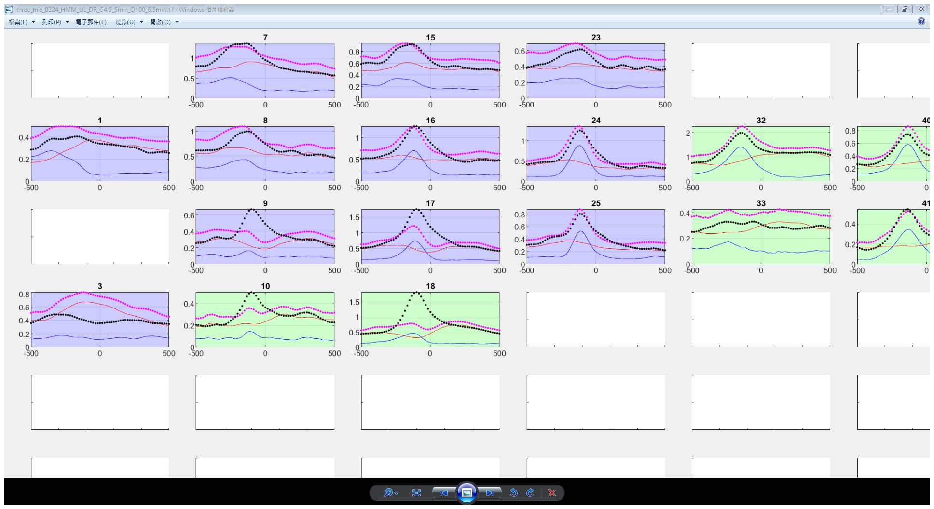
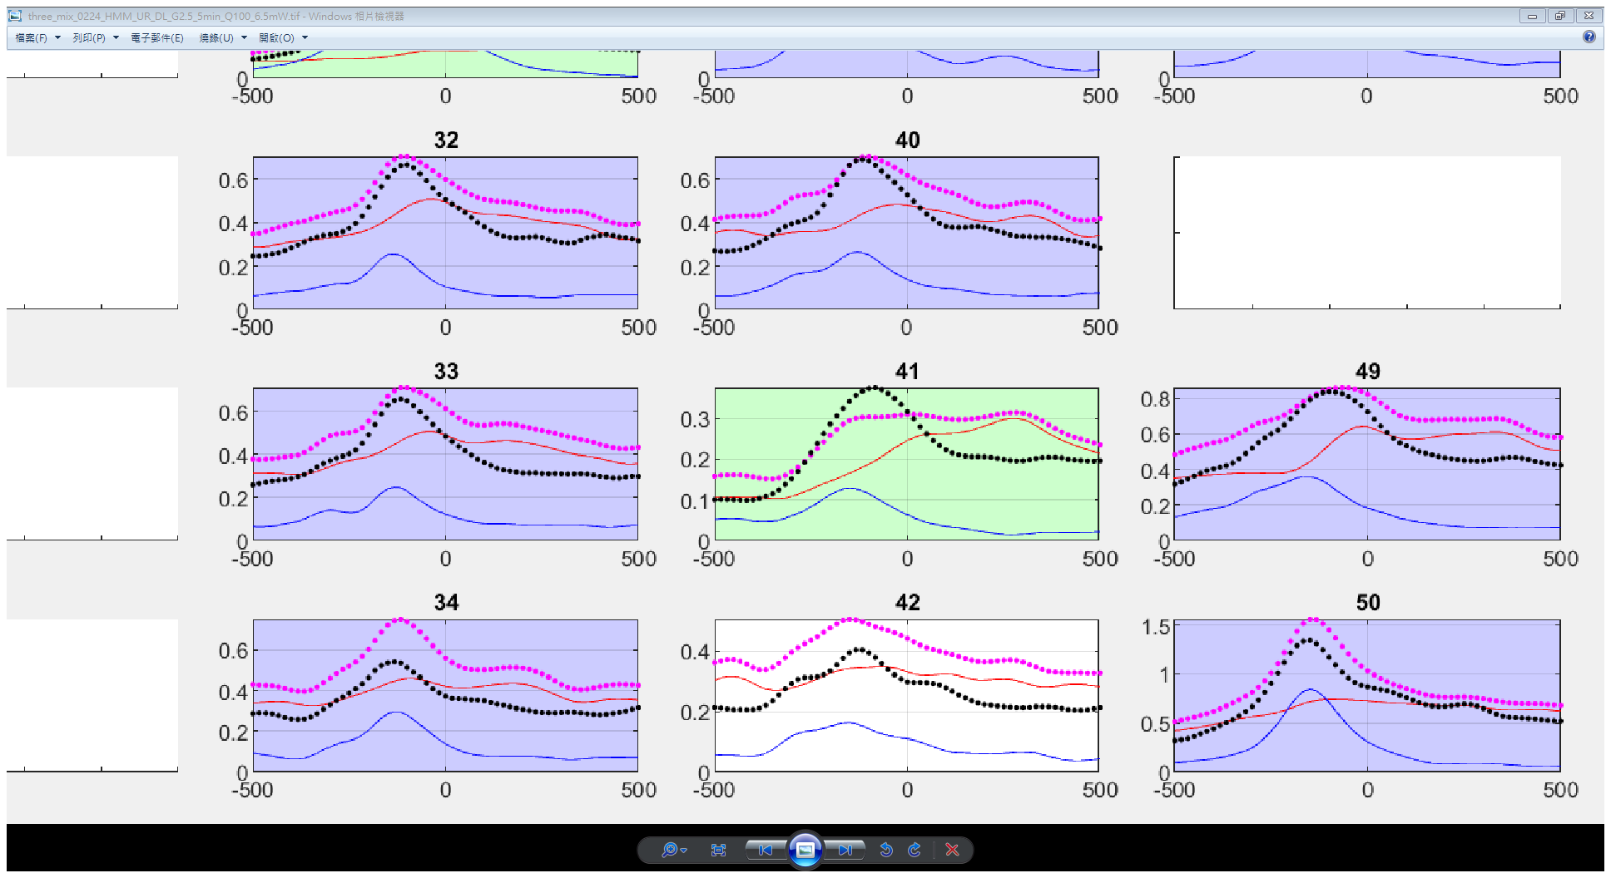
Other similar results
190225exp
190229exp (unsorted)

Slide 8
Fake spike

Slide 9
X = original HMM trajectory shifting
Response(r) = poissrnd(abs(x(t-1)^3*v(t)));
Divide Response in to four states by:
mean(r)+[std(r), 2*std(r) , 3*std(r) ]
So that the state distribution would close to firing rate (state 0 dominant)

Slide 10

MI({x, v}, $γ$) > MI(x, $γ$) + MI(v, $γ$)

Slide 11
Z is always negative
x
$$γ$$
𝛾
v
a
b
z
c

Slide 12
200229exp

Slide 13
Exceeding case
0224_HMM_UL_DR_G4.5_5min_Q100_6.5mW

Slide 14
Equal case
0224_HMM_UR_DL_G4.5_5min_Q100_6.5mW

Slide 15
Trajectory of both cases above is the same. The difference is direction.

Slide 16
MI({x, v}, $γ$) > MI(x, $γ$) + MI(v, $γ$)
0224_HMM_UL_DR_G4.5_5min_Q100_6.5mW
CH18
Didn’t minus min(shuffle_MI)

Slide 17
0224_HMM_UL_DR_G4.5_5min_Q100_6.5mW
CH18
Same data but
minus by min(shuffle_MI)

Slide 18
Z is always negative
x
$$γ$$
𝛾
v
a
b
z
c

Slide 19
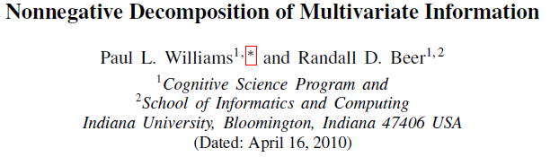
Compare with

Slide 20
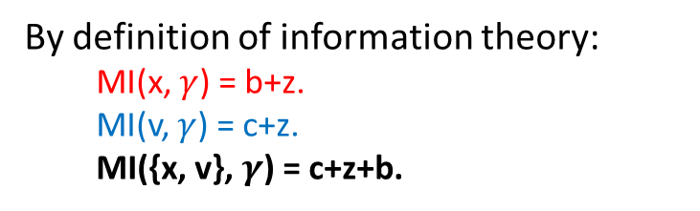
The Venn diagram I used is wrong
x
$$γ$$
𝛾
v
By definition of information theory:
MI(x, $γ$) = b+z.
MI(v, $γ$) = c+z.
MI({x, v}, $γ$) = c+z+b.
a
b
z
c

Slide 21
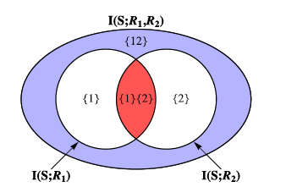
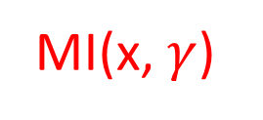
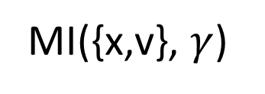
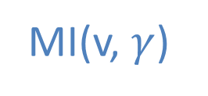
It should be
MI({x,v}, $γ$)
MI(x, $γ$)
MI(v, $γ$)

Slide 22
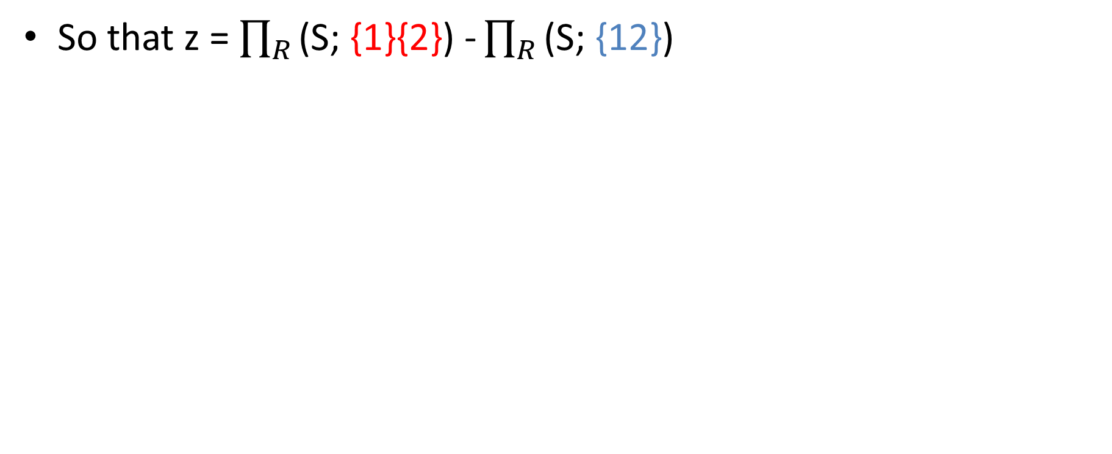
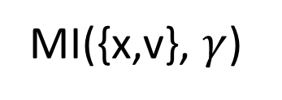
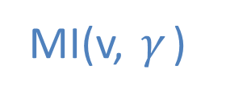
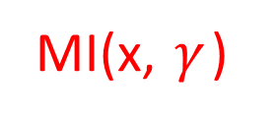
So that z = $\prod_{R}{\text{(}\text{S}\text{; \{}\text{1\}\{2}\text{\}}\text{)}\text{ -}\prod_{R}{\text{(}\text{S}\text{; \{}\text{12}\text{\}}\text{)} }}$
MI({x,v}, $γ$)
x
$$γ$$
𝛾
v
a
b
z
c
MI(x, $γ$)
MI(v, $γ$)

Slide 23
The meaning of z
INTERACTION INFORMATION: MI(x,v,r) = -z.
z = the redundant information minus the synergistic information.
z can be positive or negative.
z<0 here means there is more synergy than redundancy.
I would try to calculate the redundant and synergistic information individually.

